Slide 1
Mathematic for Computer Science - III CS203B
Lecture 3:
Fundamentals of Elementary Probability Theory - II

Slide 2

Homework from last class
What is the probability that exactly $k$letters are placed correctly ?
If you did not do it till today, please attempt it over the weekend.

Slide 3

Conditional Probability
P[$A$|$B$]

Slide 4





Conditional Probability
Given two events $A$ and $B$ defined over a probability space ($Ω$,P),
what does P[$A$|$B$] mean ?
Given that event $B$ has happened, what is the probability that event A has also happened ?
$$A$$
$$B$$
Ω
P[$A$|$B$] = $\frac{\text{P}\text{[}A\text{∩}B\text{]}}{\text{P}\text{[}B\text{]}}$

Slide 5


Conditional Probability
Given two events $A$ and $B$ defined over a probability space ($Ω$,P),
what does P[$A$|$B$] mean ?
Given that event $B$ has happened,
what is the probability that event A has also happened ?
$$A$$
$$B$$
Ω
Why should it be different from P[$A$] ?

Slide 6













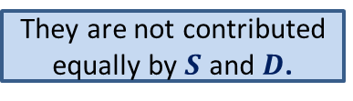
2-Coins
$$S$$
1 normal coin
1 coin with HEAD on both sides
$$D$$
A coin is picked randomly uniformly
and tossed.
Question:
What is probability that $D$ is picked ?
$$\frac{1}{2}$$
The outcome is
Why should it be different from $\frac{1}{2}$ ?
$$\frac{1}{2}$$
$$\frac{2}{3}$$
Question:
Given that outcome is H,
What is probability that
the tossed coin was $D$?
$$D$$
$$S$$
HEAD
$$Ω$$
HEAD
H T H H H T T H H H H T H H T H H H H T T H H H H T H H T H
…
TAIL
What fraction of them are contributed by $D$ ?
They are not contributed equally by $S$ and $D$.

Slide 7

Conditional Probability
Given two events $A$ and $B$ defined over a probability space ($Ω$,P),
How to calculate P[$A$|$B$] ?
$$A$$
$$B$$
Ω

Slide 8





Conditional Probability
Given two events $A$ and $B$ defined over a probability space ($Ω$,P),
what does P[$A$| $B$] mean ?
$\text{P}\text{[}A\text{∩}B$]
$$A$$
$$B$$
P[$A$|$B$] =
$$\text{P}\text{[}A\text{∩}B\text{]}$$
$\text{P}\text{[}B$]

Slide 9





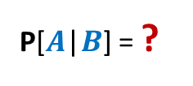



2-Coins
$$S$$
1 normal coin
1 coin with HEAD on both sides
$$D$$
A coin is picked randomly uniformly
and tossed.
Question:
What is probability that $D$ is picked ?
$$\frac{1}{2}$$
The outcome is
$$\frac{1}{2}$$
$$\frac{2}{3}$$
Question:
Given that outcome is H,
What is probability that
the tossed coin was $D$?
$$D$$
$$S$$
$$A$$
: $D$is tossed.
HEAD
$$\frac{1}{2}$$
$$\frac{3}{4}$$
HEAD
$$B$$
: outcome of toss is H.
$\text{P}\text{[}A\text{∩}B\text{]}$ =
$\text{P}\text{[}B$] =
$$Ω$$
TAIL
$$\frac{2}{3}$$
P[$A$|$B$] = ?

Slide 10

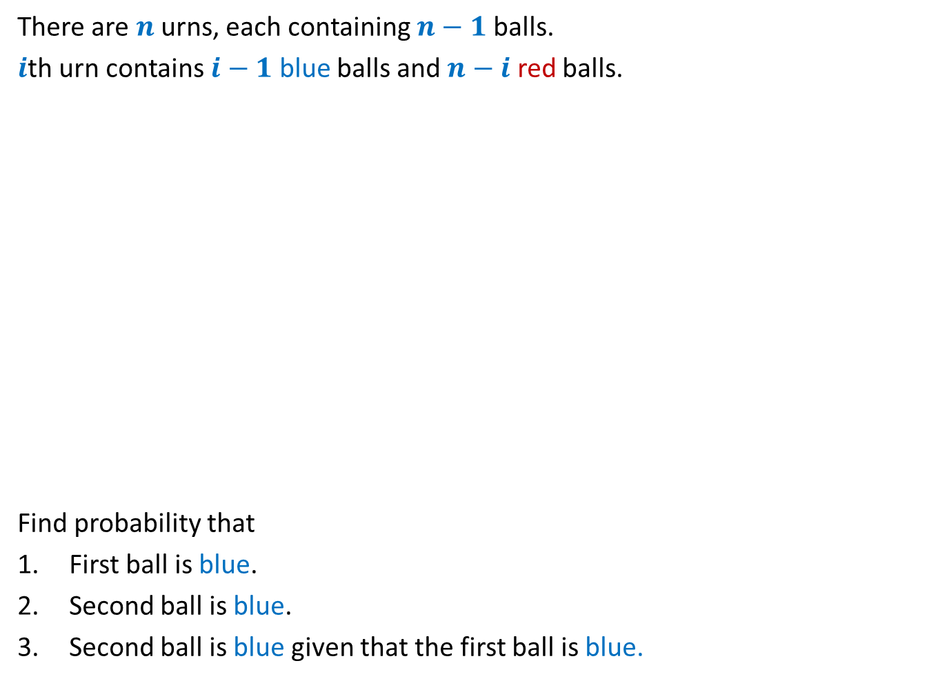



Urn problem
There are $n$ urns, each containing $n−1$balls.
$i$th urn contains $i−1$ blue balls and $n−i$ red balls.
Find probability that
First ball is blue.
Second ball is blue.
Second ball is blue given that the first ball is blue.
$$1 2 … n$$
Experiment:
1. An urn is picked at random.
2. Remove 2 balls from the urn
at random and without replacement.
$$\frac{1}{2}$$
$$\frac{1}{2}$$
$$\frac{2}{3}$$

Slide 11

5-Coins
2 normal coins
2 coins with HEAD on both sides
1 coins with TAIL on both sides
A coin is picked randomly uniformly
and tossed.
$$\frac{3}{5}$$
Question:
What is probability that outcome of toss is HEAD ?
The outcome is
The same coin is tossed again.
Question:
What is probability that outcome of toss is HEAD ?
The outcome is
The coin is thrown away.
A new coin is picked randomly and tosses.
Question:
What is probability that outcome of toss is HEAD ?

Slide 12
Independent Events

Slide 13
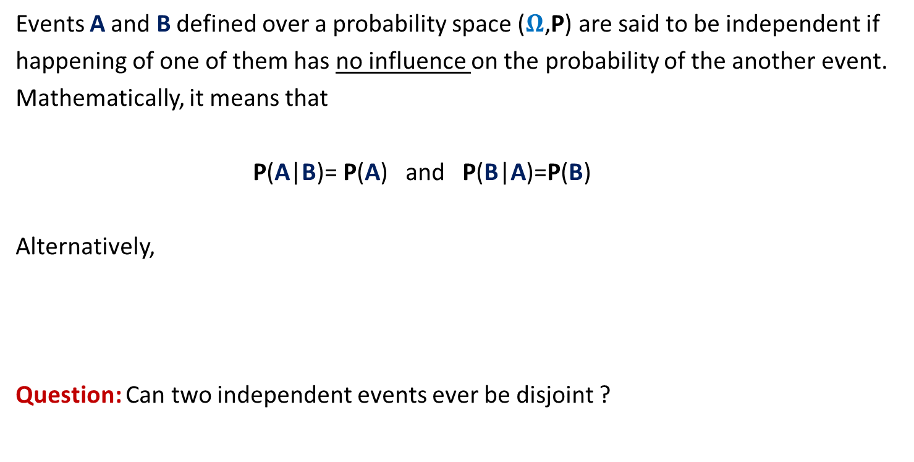
Independent Events
Events A and B defined over a probability space ($Ω$,P) are said to be independent if
happening of one of them has no influence on the probability of the another event.
Mathematically, it means that
P(A|B)= P(A) and P(B|A)=P(B)
Alternatively,
Question: Can two independent events ever be disjoint ?
P(A ∩ B) = P(A) · P(B)

Slide 14
Partition of Sample SPACE
A powerful technique to analyse some probability problem

Slide 15

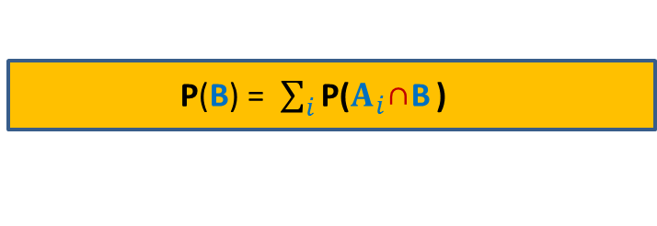






Partition of sample space
A set of events $A_{1}$,…, $A_{n}$ defined over a probability space ($Ω$,P)
is said to induce a partition of $Ω$ if
$\bigcup_{i=1}^{n}{A_{i}}$ = $Ω$
$A_{i}\bigcap{A_{j}}$ =∅ for all$i≠j$
For an event B, how can we express P(B) in terms of a given partition ?
$$A_{6}$$
$$A_{5}$$
$$A_{4}$$
$$A_{1}$$
B
$$A_{3}$$
Ω
$$A_{2}$$
P(B) = $\sum_{i}{\text{P}\text{(}A_{i}\text{∩}\text{B}}$ )

Slide 16


Sticks problem
$n$ sticks of different heights.
$n$ holes in a straight line.
Question:
What is probability that stick at $i$th place is visible ?
$$i$$

Slide 17
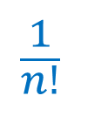




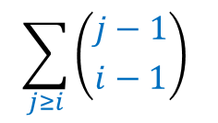
Sticks problem
$n$ sticks of different heights.
$n$ holes in a straight line.
Question:
What is probability that stick at $i$th place is visible ?
$$\frac{1}{n!}$$
$$\sum_{j≥i}{\left({j−1 \atop i−1}\right)}$$
$$⋅\left(i−1\right)!$$
$$⋅\left(n−i\right)!$$
$$\frac{1}{i}$$
$j$th smallest stick
$$i$$

